Slide 1
Solution Quiz 4

Slide 2
Answer Q1
  1. A->KDC: ID_{A} || ID_{B} || N₁
  2. KDC -> A: E(K_{a}, [K_{s}||ID_{B}||N₁ || E(K_{b},[K_{s}||ID_{A}])])
  3. A -> B: E(K_{b}, [K_{s}||ID_{A}]) || E(K_{s}, M)

Slide 3
Solution Q2
Kerberos provides a way to authenticate clients to services over a network through a trusted third party (KDC).
SSL provides secure communication b/w two communicating parties over the internet using trusted certification authority (CA)

Slide 4
Solution Quiz 3
The scheme is vulnerable to a replay attack if an old session key has been compromised then message 3 can be resent convincing B that is communicating with A. It can be improved by using timestamps.

Slide 5
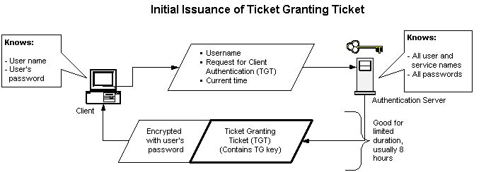
Solution Q4

